Slide 1
Cropland Classification
By Ashish Masih, Quan Nguyen, Shubham Saraf, Salem Nyacyesa.

Slide 2
Timeline
Motivation
Background knowledge
Obtaining datasets and preprocessing
Objective 2: crop vs no crop
Objective 3: crop classification
Objective 4: crop growth prediction
Future works

Slide 3
What is Crop Classification?
Cropland Data Layer (CDL) is provided free by USDA.
Available every year (with 1 year delay).
Classified using satellite imagery (e.g. LANDSAT) and ground truth data.
Farmers have a legal contract with USDA to provide the info. (i.e. very reliable).

Slide 4
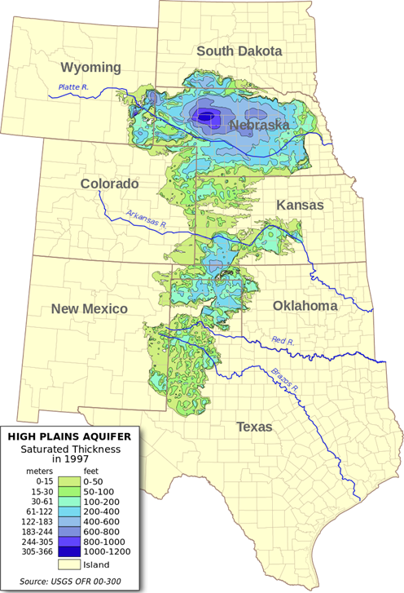
What is the need?
Every farmer wants more water, BUT……..
Remote sensing models for crop water consumption require knowledge of planted crops spatially.
These models are used of irrigation/farm management decisions.
Models run in near real time to dynamically forecast irrigation demand.
Ogallala aquifer slowly depleting.

Slide 5
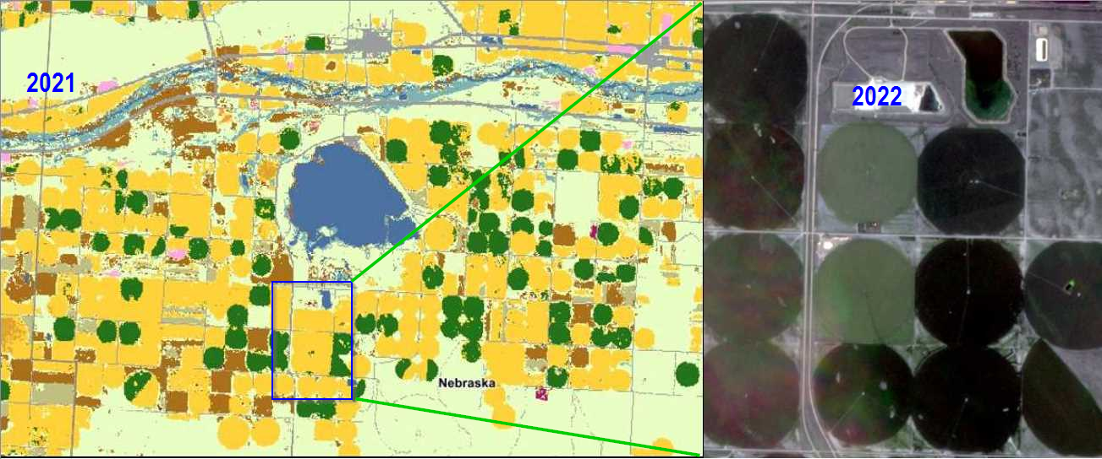
CDL & LANDSAT image.
Difference in most recent CDL Vs actual crop due to the lag in availability.

Slide 6
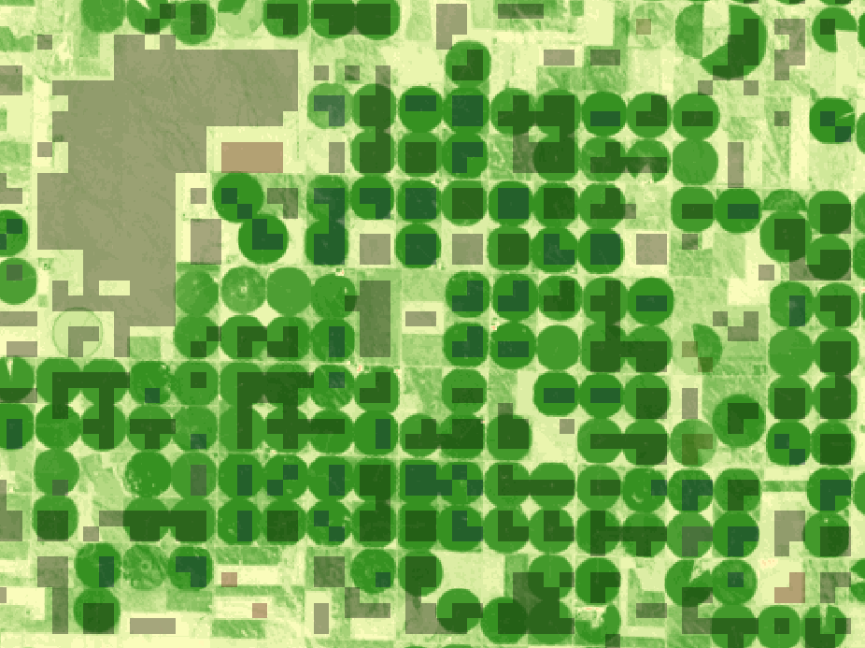
Objective: Preprocessing:
Normalized Difference Index (NDVI)
A very well known plant growth indicator in agricultural community.
It was calculated for all image dates.
NDVI = (NIR - Red)∕(NIR-Red)
Original dataset size ⇒ Approx. 89 GB. (N,R,G,& IR bands)
Downsampled dataset ⇒ Approx. 2 GB (NDVI & IR)
NDVI image, with 0% mixed classes.

Slide 7
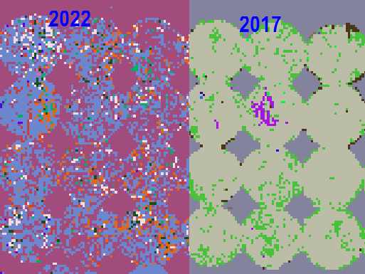
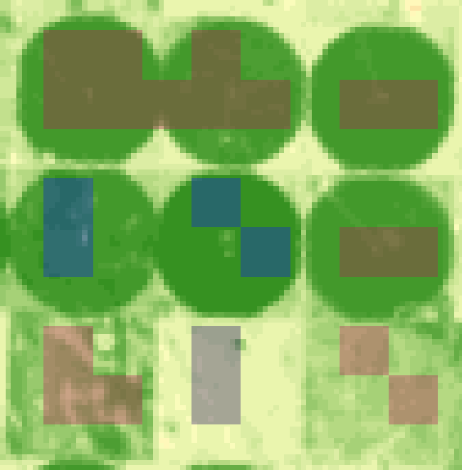
Preprocessing: Continued…
A moving window of 9x9 pix. to filter out mixed signature.
CDL classification incorrect classes

Slide 8
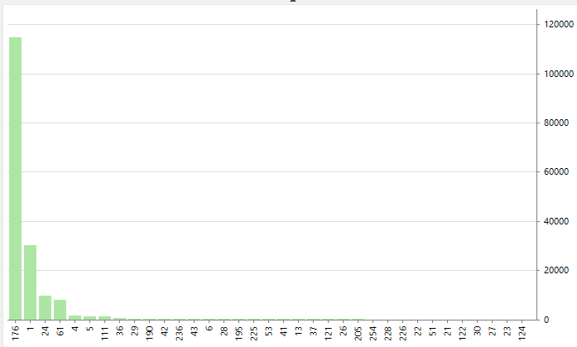
Preprocessing: Continued…
Percent | Crop ID | Crop Name
65.8 | 176 | Grassland/Pasture
19.7 | 1 | Corn
6.3 | 24 | Winter Wheat
4.6 | 61 | Fallow/Idle cropland
1.3 | 4 | Sorghum
0.8 | 5 | Soybeans
CDL distribution 2022
(after moving window filtering)

Slide 9
Objective 2: Crop vs no crop classification
The goal is to classify land in an image into crop or no crop areas.
No crop areas include Forest, Shrubland, Barren, Wetland, Nonag, Aquaculture, Open Water, Snow, Developed area and Grassland.
Brightness temperature (apparent temperature) is a measurement of the infrared radiation as seen by the satellite at top of the atmosphere.

Slide 10
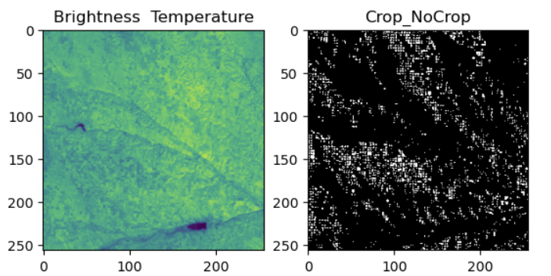
Crop vs no crop: Dataset
Brightness Temperature
Original image is 837x845
Sampled into 256X256

Slide 11
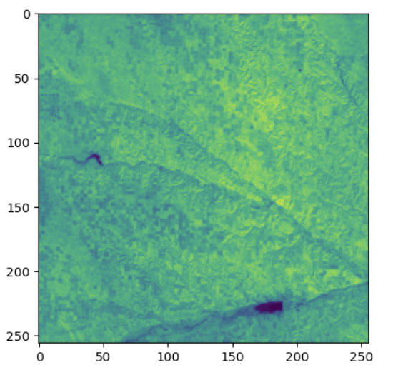
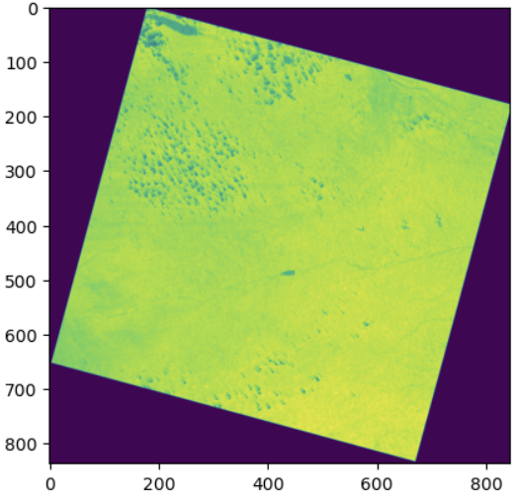
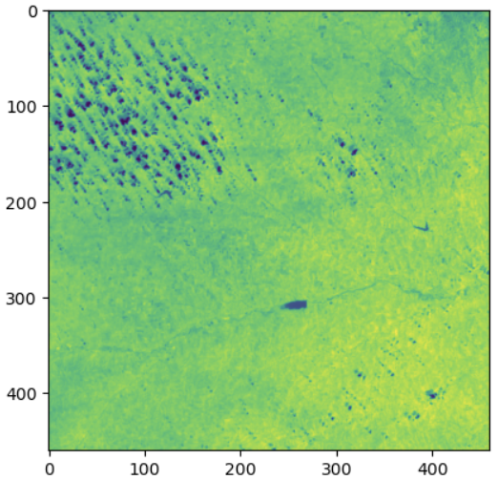
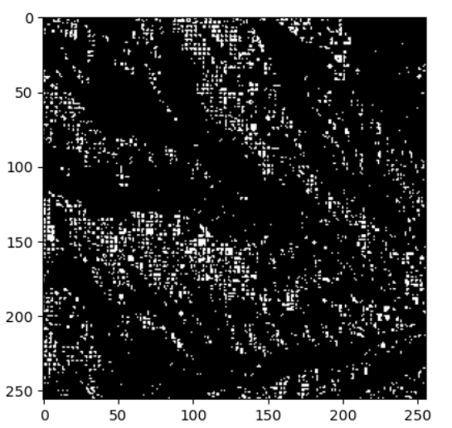
Crop vs no crop: Dataset

Slide 12
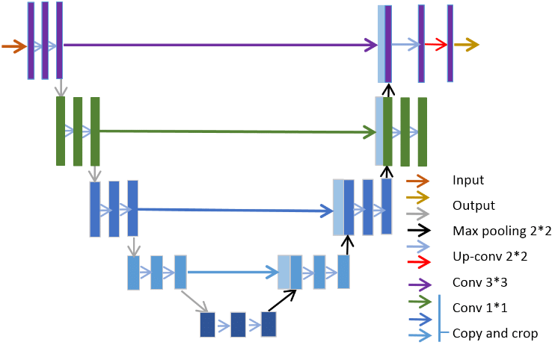
Crop vs no crop: Model Architecture
UNets
Have 5 level for contraction and expansion
Dropout is used to prevent overfitting.
Dimension is halved and number of channels is doubled as we go to higher level
Each level ends with pooling layer for downsampling.
For expansion last layer of contraction is added.

Slide 13
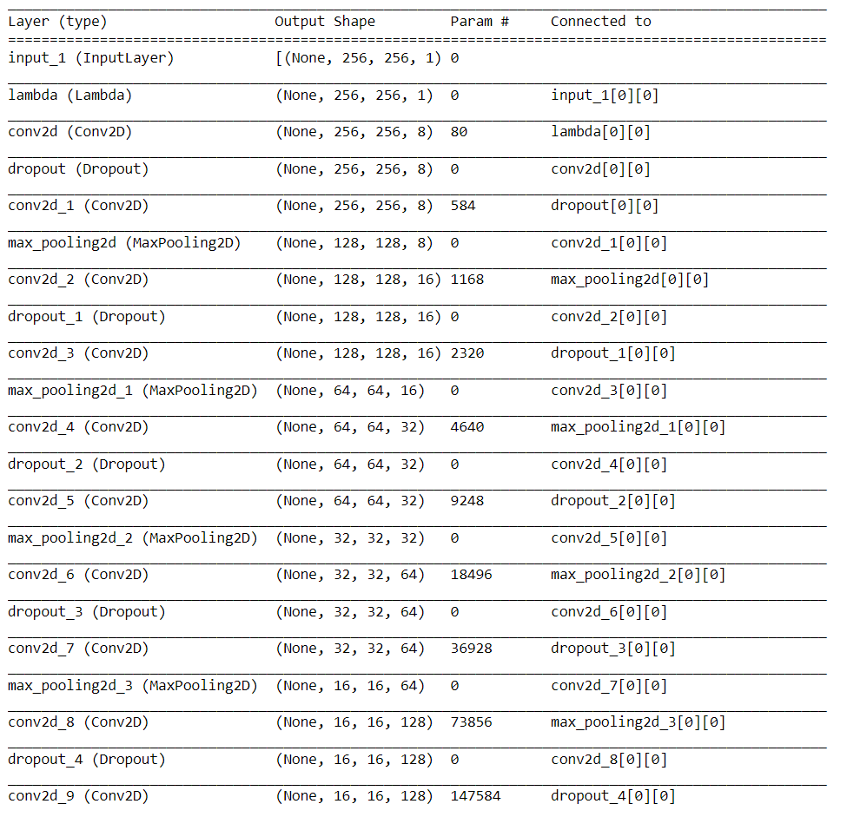
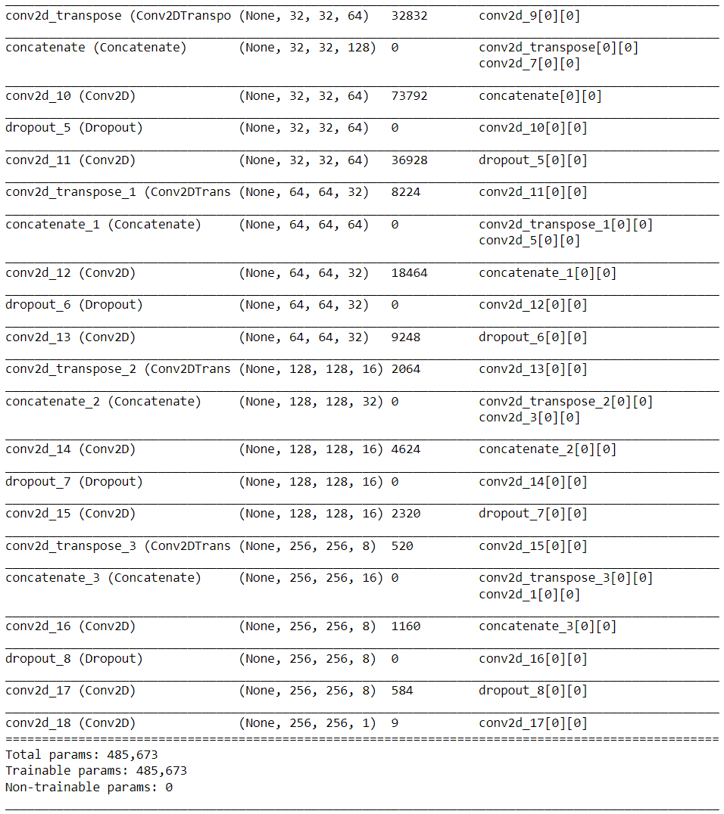
Crop vs no crop: Model Architecture

Slide 14
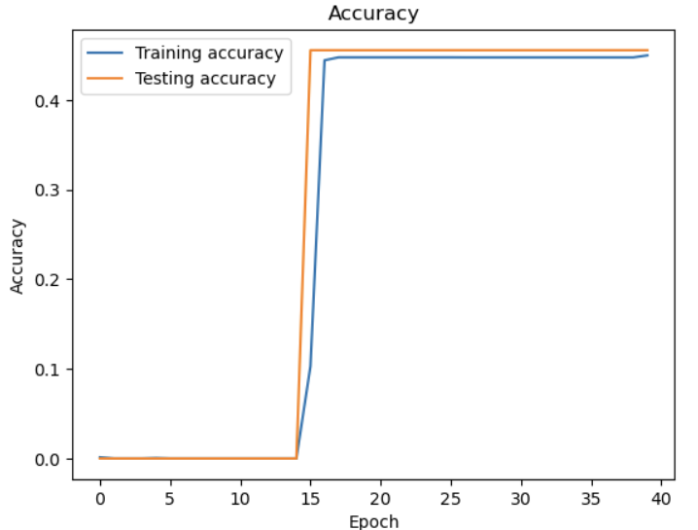
Crop vs no crop: Results
After training for 50 epochs accuracy was at 45% and increasing.
There is huge spike in accuracy around epoch 15, due to limiting computation resources, going further is not an option.

Slide 15
Crop vs no crop: Model weaknesses
A large number of parameters: UNet has many parameters due to the skip connections and the additional layers in the expanding path.
High computational cost: UNet requires additional computations due to the skip connections, which can make it more computationally expensive than other architectures.
Sensitive to initialization: UNet can be sensitive to the initialization of the model parameters, as the skip connections can amplify any errors in the initial weights. This can make it more difficult to train UNet compared to other architectures.

Slide 16
Objective 3: Crop classification
The goal is to classify crops in an image into one of 15 crop types.
The dataset is a set of images encoding the Brightness Temperature of that region.
Brightness temperature (apparent temperature) is a measurement of the infrared radiation as seen by the satellite at top of the atmosphere. Reduction in signal strength due to haze, cloud, refraction etc. not considered.

Slide 17
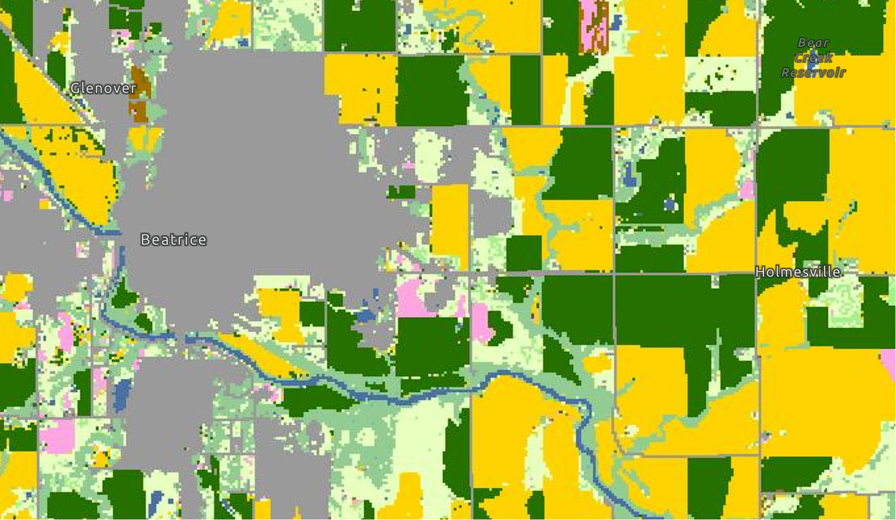
Crop Classification: Data Augmentation
Each image is originally 900 x 900.
Images of size 128 x 128 are sampled from the original image and are used for training and testing.
The sub-image is then compared against USDA NASS Cropland Data to obtain crop labels.
Image obtained from USDA NASS Cropland Data

Slide 18
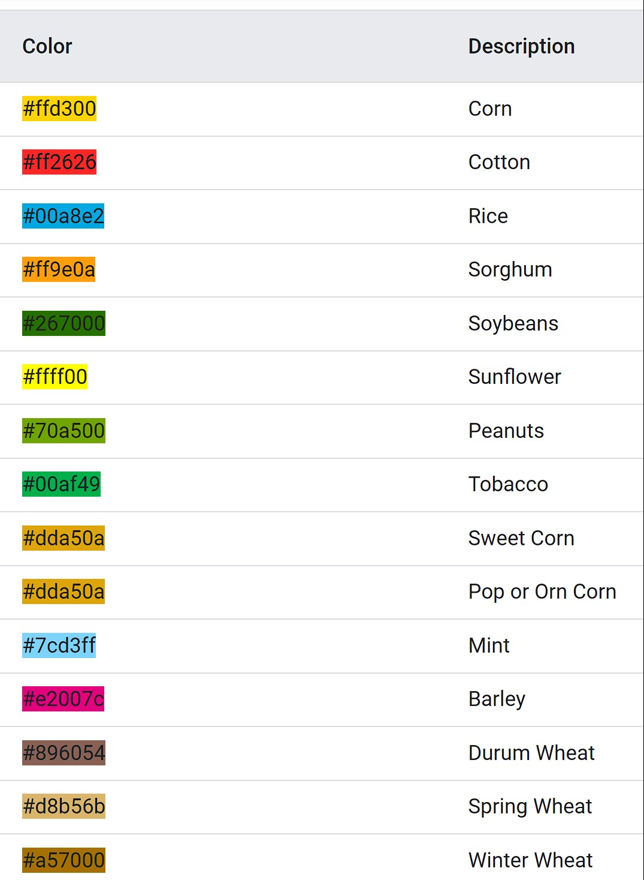
Each region then receives 3 labels corresponding to the 3 crops it has the most.
There are 15 crops totals.
90,000 images generated
20% is set aside as test datasets
Among training images, 20% is saved for validation.
Some restrictions are applied to prevent one label to dominate the dataset.
Labels obtained from USDA NASS Cropland Data

Slide 19

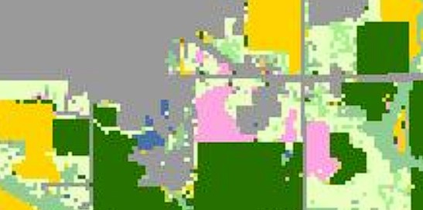
Sampled sub-image

Slide 20
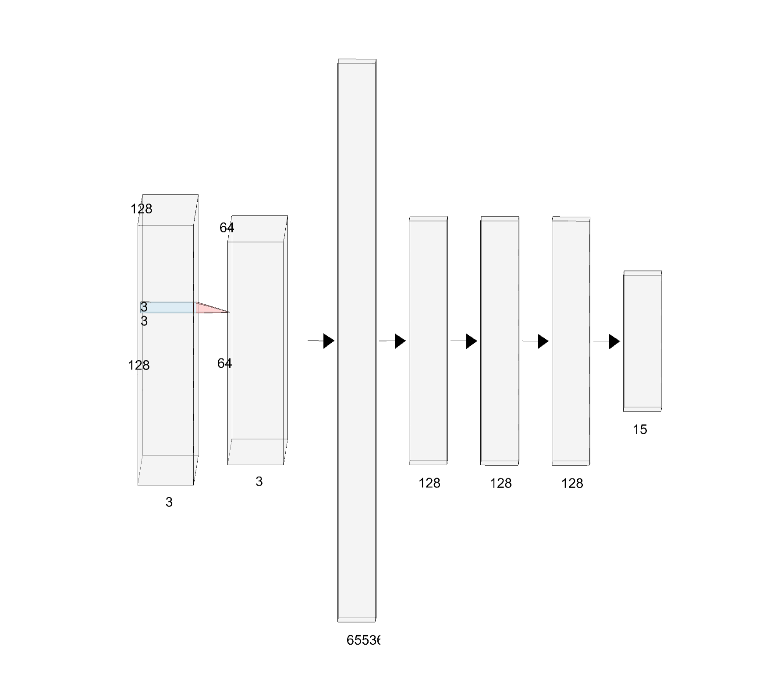
Crop Classification: Neural Network
All layers are followed by a ReLU activation channels except the output layer which uses softmax activation.
2 CNNs layers with 32 and 64 channels.
Each layer is followed by a batch normalization layer and a max pooling layer
4 fully-connected layers with 128 nodes each
A batch normalization layer after the first FC layer
A drop-out layer after the third layer.
Loss function is cross entropy.
Optimizer is Adam for adaptive learning rate.

Slide 21
Issues while building models
Exploding gradients
Batch normalization: reduce covariate shift
Gradient Clipping: Prevent the gradient from exceeding certain value (0.01)
Slow training due to huge dataset
Randomized training images: initially 80% of training images are used. At every 5 epochs, 10% of training images are removed and 10% of new training images are loaded into memory.

Slide 22
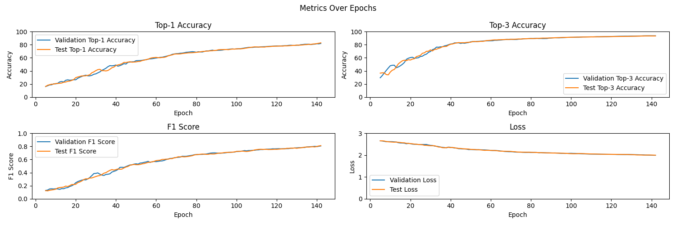
Crop Classification: Results
After 140 epochs, the model reached 82% and 94% accuracy for top 1 and top 3 respectively.
From the graph, the model has not converged yet. However, due to limiting computation resources, going further is not an option.
The model is not overfitting because test accuracy still increases at similar rate to validation accuracy.
F1 score is used because some labels such as corn represents more than 20% of all labels.

Slide 23
Objective 4: Crop Growth Prediction
After obtaining the crop classified from an image, objective 4 focuses on predicting the growth stage of that particular plant.
The predicted growth stage will be compared to the actual growth depending on the particular crop growing season and the actual dates on which the satellite image was taken.
NDVI (Normalized Difference Vegetation Index) and EVI (Enhanced Vegetation Index) are vegetation indices that measure the amount of healthy vegetation in a given area. During different crop growth stages, the health and density of vegetation change.
Lower NDVI or EVI values may indicate early growth stages or stress, while higher values often correlate with mature and healthy vegetation. Monitoring these indices over time can provide insights into the progression of crop growth.
By analyzing the temporal trends in these indices, it becomes possible to identify distinct phases of crop development, such as emergence, vegetative growth, flowering, and maturity.

Slide 24
Future works
Crop vs no crop
Optimizations for faster training and inference.
The transfer learning approach with fine-tuning of the pre-trained weights
Crop classification
Detect where each crop is in each image while classifying them.
Larger dataset: expand outside of US; more crops; more signals
Optimizations for faster training and inference.
Generating cleaner segmentations of CDL using multi year data.
Crop growth
Predicting sowing and land preparation dates from brightness temperature and current weather patterns.

Slide 25
Questions?

Slide 26
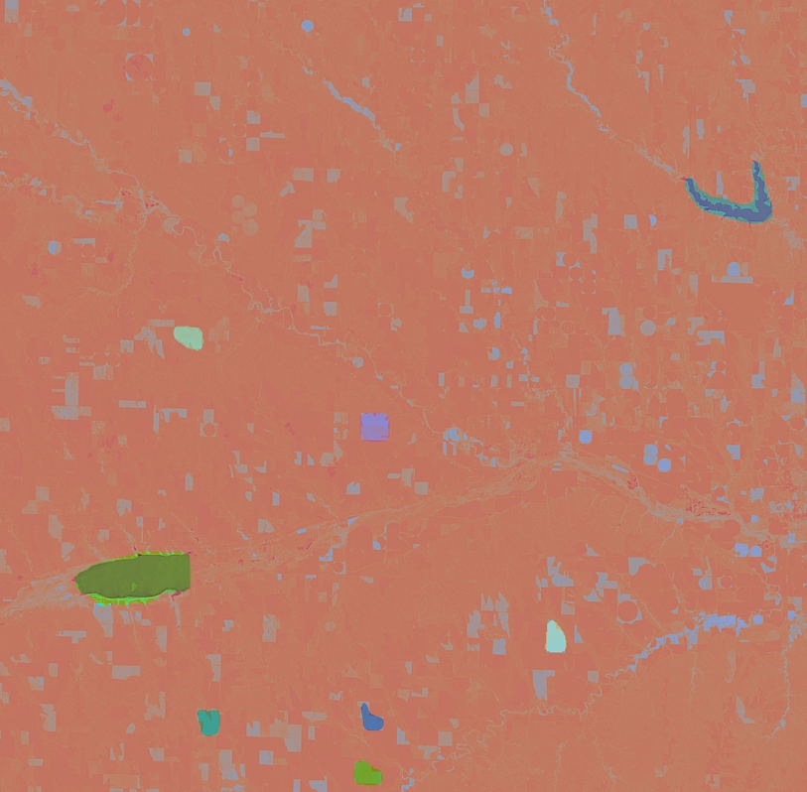
Partial success in Segment Anything Model.

